Slide 1
Most Important Resources in Azure

Slide 2
Azure Virtual Machines
Virtualization
In general, virtualization refers to the process of simulating something.
The technique of operating a virtual instance of a computer system in a layer separate from the real hardware is known as virtualization.
It most often refers to the use of several operating systems on a computer system at the same time.
So, if you have a Windows computer, you may run a Linux-based operating system in a Windows virtual machine by using technologies like VMware, which supports Virtualization.

Slide 3
Azure Virtual Machines (Infrastructure As A Service)
Azure Virtual Machines are an IAAS offering
Azure Virtual Machine:
a. Are cost-effective
b. Multiple resources are created along with VM when created
c. Users can choose amongst a variety of available configurations and OS as per the requirements.
With regular use of a Linux operating system through virtualization, one must download software such as VMware and certain files linked to the Linux OS itself, but this is not the case for Azure Virtual Machines, which can be run in the cloud itself.
We don't need to download any hefty software since we can connect to the VM directly in many ways.
Two of those ways are:
● Using Remote Desktop Connection (RDP)
● Using Azure Bastion Service A public IP address is assigned to the virtual machine for it to communicate with the internet. It's important to know how virtual machines are created in azure.

Slide 4
Azure Virtual Networks
Azure Virtual Machines are hosted in an Azure Virtual Network. In Azure, you create your virtual network. If necessary, you may build several virtual networks in Azure. Each virtual network in azure needs to be assigned to an address space. Example of an address space 15.0.0.0/16.
Some called subnets have an address space that is a subset of the virtual network. As there can be many subsets for a set of numbers, there can be many subnets for a virtual network. You can spin up a virtual machine in a subnet, each machine launched in a subnet gets a private IP address. A private IP address facilitates inter-subnet communication.

Slide 5
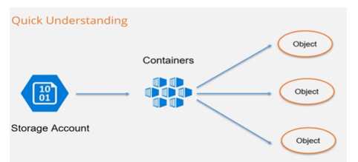
Azure Storage Accounts
Azure Storage includes massively scalable object storage for data objects, a cloud file system, a messaging store for secure communications, and a NoSQL store. Azure Storage accounts are extremely durable and available.
Blob Storage
Blob Storage is useful for storing videos, images, large files, log files, etc. Blob storage stores things in the form of objects.
There are three types of storage tiers available in blob storage.
Hot tier - frequently accessed.
Cold Tier - less frequently accessed.
Archive Tier - rarely accessed.

Slide 6
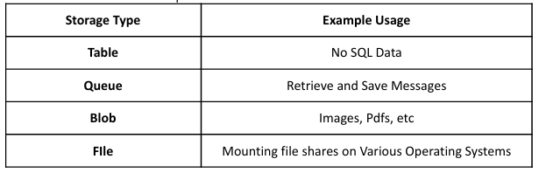
Table Storage :It is a low-cost method of storing table-like data for applications. This type of storage is a key- attribute storage and is most significantly utilized for NoSQL data.
File Storage :File Storage uses the Server Message Block Protocol to retrieve files. It can be used to mount file shares on Windows, Linux, and Mac machines.
Queue Storage: It is a messaging service offered by Azure. It is used to retrieve and save messages. A queue may hold millions of messages.

Slide 7
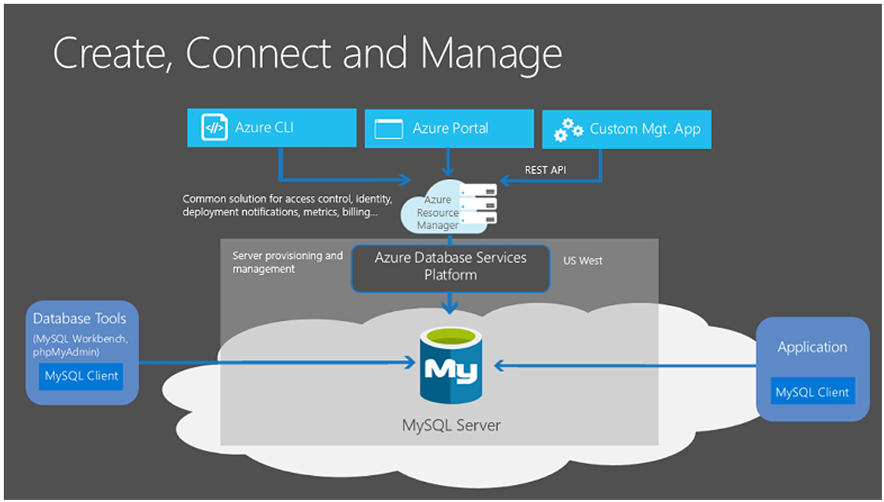
Azure Database Services

Slide 8
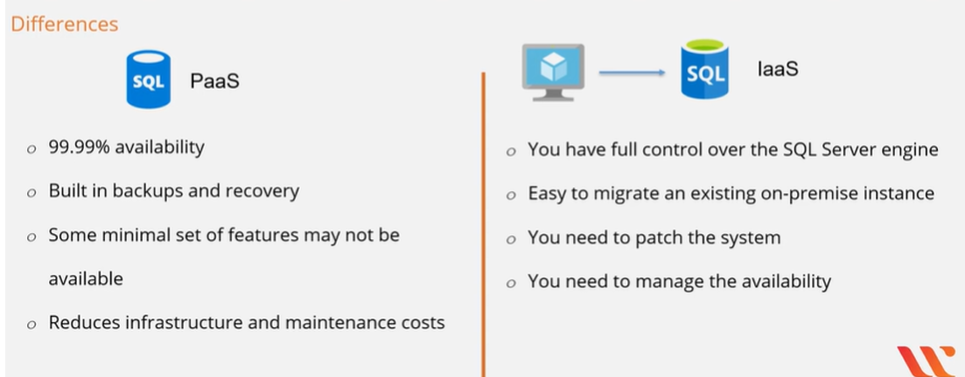
In Azure, there are several Database services to choose from. They are as follows:
Azure Cosmos DB (Serverless Multi-Model Database)
We can achieve low-latency data access by using the Azure Cosmos DB service. It includes a capability that allows for data replication in real-time. It is automatically scalable. It also provides 99.999 % read and write availability.
Azure SQL Database (PaaS)
Azure SQL Database provides us with 99.99% availability. It has a built-in backup and recovery feature. We can also host a SQL Server on a virtual machine, but it wouldn’t remain PaaS.
Comparison

Slide 9
Azure Database for MySQL(PaaS)
This is a MySQL Community Edition available in azure that comes in with high built-in availability as well as automated backups and restoration points.
Azure Database for PostgreSQL(PaaS)
This is a PostgreSQL Community Edition available in azure that comes in with high built-in availability as well as automated backups and restoration points.
SQL Managed Instance
In SQL Managed instances, the underlying database engine is almost 100 percent compatible with the newest SQL Server Enterprise Edition database engine, which is the primary advantage.
This makes it simpler for businesses to migrate existing SQL Server workloads to Azure.

Slide 10
